Slide 1

Preparing Student Presenters
WORKSHOPS
Prepared for MASC….
Karen Crawford 2010

Slide 2
Objectives
To review essential elements of a student workshop (content, delivery, visual, other)
See resources available to help students present quality workshops

Slide 3

Gallery Walk

Slide 4

Gallery Walk
Walk around and add items you feel are important for each category….
CONTENT
DELIVERY
VISUAL AIDS
OTHER

Slide 5
Distribute Checklist
Compare the handout checklist and add items that were generated during the gallery walk….

Slide 6
Content
Written outline of workshop includes “running time” (how long an activity takes
and the total workshop time used up to that point)
Applicable to students’ interests (relevant)
“up-to-date” information/statistics
encourages thinking and self exploration
introduction - grabs attention (immediately engage)
clearly defined objectives
concepts in logical sequence
concepts flow well (transitions are smooth)
concepts given support from visual aids as appropriate
sufficient detail to support the main points
activities to allow participants to process/understand concepts
variety of activities (not just “lecture”)
closing summarizes the workshop clearly and concisely
conclusion strong (not just "I guess that’s it.")
allow question/answer session as appropriate
have an energizer planned just in case
have a “plan B” to shorten an activity or something that can be cut out if time
becomes a factor and also have an extra activity incase you have extra time!

Slide 7
Delivery
knowledgeable about the topic covered in your presentation
notes in order
know the content - do not read from a paper or slide (be knowledgeable about the topic)
visual aids in order (pre-rolled tape to put up visuals or equipment set and ready)
use wording appropriate to the audience, not above or below them.
refer to your handouts. Don't just say, "Look it over later." A good technique is to leave several blanks to be filled in during the workshop
questions? address responses to everyone, not just the person who asked the question
avoid fillers: “umm" "you know"
speak loudly enough to be heard in the room
pronounce words clearly
avoid speaking too rapidly (speak slowly)
no significant loss of eye contact from reading a slide or gesturing toward it (do not read
“word for word” to audience from a slide)
varied voice pitch for emphasis
eye contact - look at entire audience (watch “blind” corners)
speak key points (such as conclusion) without reading
avoid nervous hand movements – be aware of your body language – charisma!!
smile - Be enthusiastic and energetic
manage the timing/delivery of the workshop
PRACTICE PRESENTING THE WORKSHOP!!

Slide 8
Visual Aids
visuals tied into the points you are trying to communicate
easily seen from all areas of the room
appropriate number of words and images on slides (not overloaded - focused on
critical elements, not excessive in detail) - not “wordy”
background does not interfere with points or text
sufficient "white" space to (don’t overcrowd everything on one poster or slide) –
check the spelling!!
have tangible props when possible
use images that suit purpose and are appropriate for audience
color choices should be easy to view (don’t use light markers – more difficult to
see; white lettering on a dark slide is not as readable as dark lettering on a lighter
slide)
colorful and “attention grabbing!”
have a back-up plan if computer/LCD projector does not work or is not available
(check technology!)
use font types, sizes, and colors that can be read easily (not too fancy, not vertical
lettering, etc.)

Slide 9
Other
dress appropriately so your clothing is not
distracting to the presentation
rewards (candy – to keep audience engaged?)
create an environment that is safe to share
ideas
arrive early to set up the workshop room
have FUN!

Slide 10
Measuring Success
Measuring the success or failure of a workshop goes beyond mere participant satisfaction of--hopefully--an enjoyable and constructive workshop. It is measured in terms of:
to what extent objectives were achieved
what thinking, behavior or activity changes have taken place,
will take place or have been confirmed as a result of the
workshop
what action results as a consequence of the workshop

Slide 11
Workshop Outline
….example of workshop outline with time for each activity and time running….

Slide 12

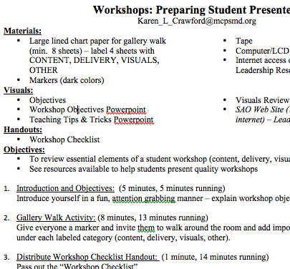
Workshop Outline: time and time running

Slide 13
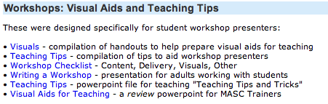
Resources
http://www.montgomeryschoolsmd.org/departments/studentaffairs/sao/resources/#visuals

Slide 14

View Slide Show

Slide 15

View Slide Show

Slide 16
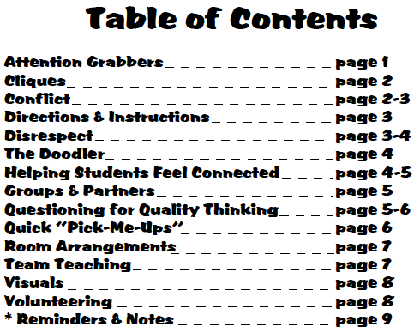

View Handout

Slide 17


View Handout

Slide 18
Review Objectives
Reviewed essential elements of a student workshop (content, delivery, visual, other)
Looked at resources available to help students present quality workshops

Slide 19
QUESTIONS
Karen Crawford 2010

