Slide 1
Teaching
TIPS AND TRICKS
Key points for making your workshop successful!
(Karen Crawford / Marcy Leonard)

Slide 2
Objectives
By the end of this review, trainers will have:
Reviewed facilitation strategies
Re-considered their role as a trainer
Generated a list of good/poor trainer behaviors
Refreshed their memory on making visuals
(Karen Crawford / Marcy Leonard)

Slide 3
“Who dares to teach must never cease to learn.”
John Cotton Dana author and librarian

Slide 4

Gallery Walk Review
Notes:
What do you remember from your training and workshop experiences?
List as many things as you can remember concerning the topics you see around the room.
giving directions
get-to-know games
breaking into groups
behavior management
attention getting strategies
checking for understanding
general facilitation
Review from charts – add important items that may have been forgotten (refer to handout)

Slide 5
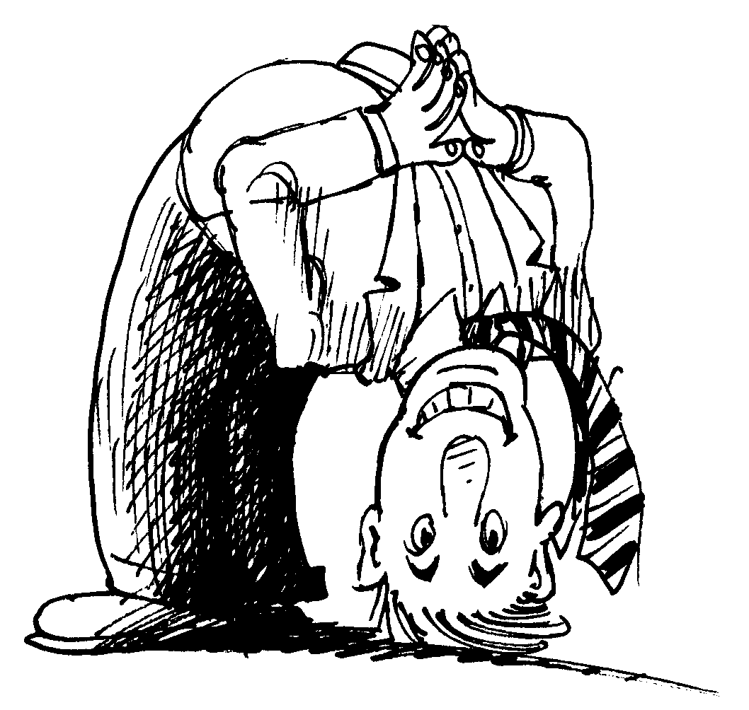
WHO ARE YOU AND
WHO ARE THE DELEGATES?
Teacher and Student?
Adult and Kid?
Leader and Follower?
Student and Student?
Facilitator and Participant?
Peers?

Slide 6

Good Trainers…
Poor Trainers…
Marker Race
Notes:
List as many items that you can think of that make a good or poor trainer
(on chart paper – draw a line down the middle and list both on one chart)

Slide 7
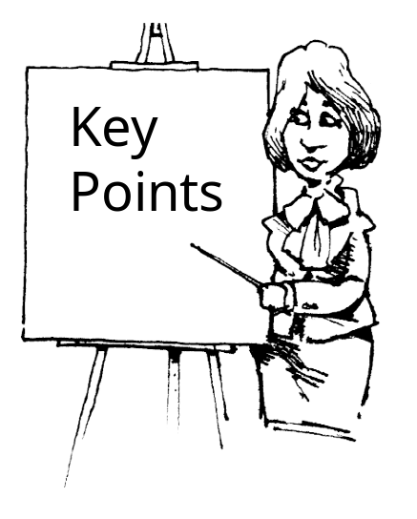
Review
Good/Poor
Trainers
Notes:
GOOD
Enthusiastic but not over active
Flexible
Know your workshop
Exude Energy
Maintain eye contact (get the “corners”)
Use delegates’ names
Include a variety of teaching techniques
Don’t distract during partner’s presentation
Pay attention and be ready to jump in…
Allow for wait time
Repeat (paraphrase) so whole group can understand
“Reward” correct answers (good/excellent)
Greet delegates at the door
Use easy to see visual aids
POOR
Sloppy/hard to see visuals
Arrogant
Soft spoken
Poor body language
Don’t pay attention to group work / partners
Playing with cell phone

Slide 8
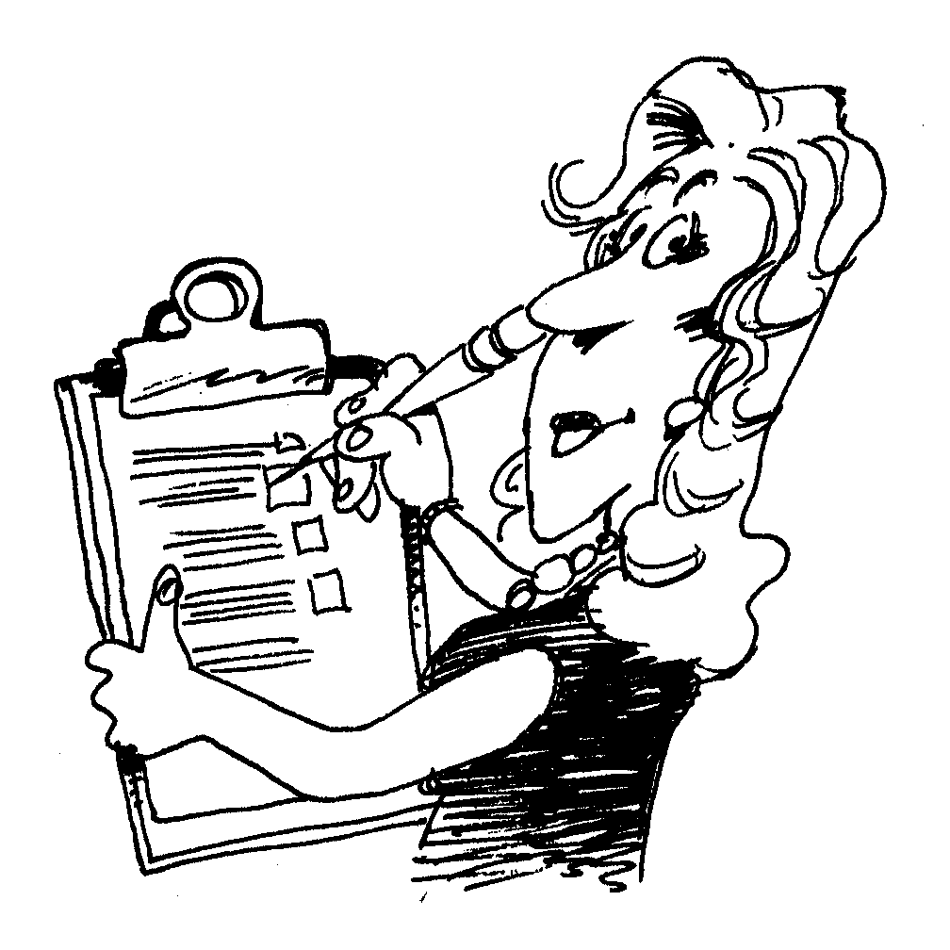
Review
Tips
Notes:
What kinds of things can you do in your workshop to help your delegates learn better?

Slide 9
“Tell ‘em what you’re going to tell ‘em, tell ‘em, tell ’em what you told ‘em.”
Notes:
Review objectives at start of workshop to set the stage.
Refer back to individual objectives throughout workshop.
Review objectives at end of workshop and conduct a closure activity to assess level of knowledge (exit slip, bluff game, one thing you learned today, etc.)

Slide 10
Ensure smooth transitions between activities
Notes:
Do a real run-through pre-site with someone in the room acting as a delegate.
Write a script with specific trainer actions as well as dialogue. Include items like making tape balls, uncovering visuals, setting up items for next activity, etc.
Decide ahead of time how delegates will be divided into groups (count off by numbers or names, hand out props, use birthday months or hair color, etc.)

Slide 11

VISUALS REVIEW
Notes:
See ppt review

Slide 12
More
Review
Tips
Notes:
What kinds of things can you do in your workshop to help your delegates learn better?

Slide 13

GIVING DIRECTIONS
Don’t do anything else while you give directions!
Notes:
Re-emphasize

Slide 14

IDEA GENERATING
ABC
Gallery Walk
Marker Race
Popcorn Style
Snowstorm
Whip
Notes:
Other ideas?

Slide 15
Be a good visitor to your host’s classroom
Notes:
Create a map of the classroom before moving any furniture of items.
Return everything to the way you found it.
Clean the room (recycle paper trash). Look for “lost and found” items left by delegates.
Take all your items with you.
Leave a thank you note.

Slide 16
Objectives
DID YOU….
Review facilitation strategies?
Consider your role as a trainer?
Generate a list of good/poor trainer behaviors?
Refresh your memory on making visuals?
(Karen Crawford / Marcy Leonard)

Slide 17
Good
Luck!

