Slide 1
Goal Setting...
A Road Map to Success

Slide 2

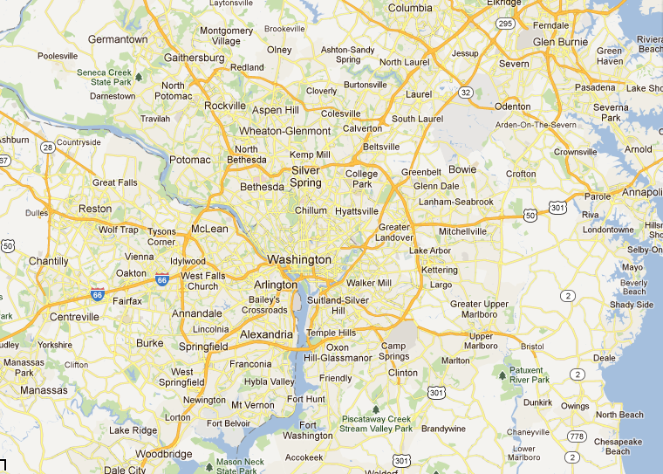

Goals are specific, realistic reminders of the accomplishments you visualize.
Notes:
Could you image taking a driving vacation without a map? Think of all of the wasted valuable time that would be spend trying to find your way. The same thing can happen to you if you haven’t set some goals.
One of the most important aspects of success is the ability to define and achieve goals.
Goals are specific, realistic reminders of the accomplishments you visualize.

Slide 3


You can set:
• long-range goals
• intermediate goals
• short-range goals
Example….
Notes:
You can set:
• long-range goals (college, career)
• intermediate goals (this class, this semester,
this season)
• short-range goals (this week or today)
(example: Your overall goal might be to be accepted at a certain college; your sub-goals might be to get all As and Bs this semester, get involved in clubs, win a scholarship, and this week you will finish all homework/reports by Friday night)

Slide 4

Goals are important in:
• academics
• student leadership
• personal affairs
Apply your goals!
Write goals down!
Notes:
Goals are important in academics, student leadership and personal affairs.
Apply goal setting to all areas in your life and your group activities.
Write down your goals and refer to them often.

Slide 5

ARE YOUR
GOALS SMART?

Slide 6
S
Specific

Slide 7
M
Measurable

Slide 8
A
Action
Oriented

Slide 9
R
Realistic

Slide 10
T
Timely

Slide 11
SMART
Specific
Measurable
Action Oriented
Realistic
Timely

Slide 12
Performance
Measuring
Tips

Slide 13
Performance Measuring Tips
Data accuracy is essential...
Notes:
It does not good to record data if it is not accurate – it is very important to have concrete data

Slide 14
Performance Measuring Tips
Measure what is important...
Notes:
Measure what is really important, not little things that really don’t make a difference.

Slide 15
Performance Measuring Tips
Don’t measure what you can’t or won’t use...
Notes:
This reinforces what data you are collecting and looking at –
There is no need to measure data that you can’t use or don’t want to use – that is an exercise in wasted time.

Slide 16
Performance Measuring Tips
You can’t improve what you can’t - or won’t measure...

Slide 17

Benefits of
Goal Setting

Slide 18
Awareness of weaknesses…..
Helps visualization and planning….
Responsible for yourself….
Accomplishments and motivation…..
Real life actions…..
Awareness of strengths…..
Set priorities – limit distractions…..
Serves as a guide…..
A path to follow….
Notes:
Makes you aware of your weaknesses so you can begin to improve them and make them into strengths
Makes you responsible for your own success or failures
Defines real life actions -- separates it from just wishful thinking
Forces you to set priorities, therefore helping you to limit getting involved in distracting things
Gives you a “track to run on” - a path to follow, so you know where you are going
Helps you to visualize and plan actions to achieve what you want -- then carry it out
Gives you a sense of past victories of goals accomplished and motivation to succeed in current goals
Makes you aware of your own strengths
Serves as a guide in making decisions

Slide 19
Now you’re ready for a
Goal &
Action Plan

Slide 20
My Goal:
How I will obtain my goal (action plan):
1.
2.
3.
My GOAL IS:
• realistic and attainable
• challenging
• target date for completion
• measurable results
• clear, specific and
understandable
• meaningful and desirable
beneficial
• action plan has at least
two methods to help
attainment of goal

Slide 21
Be SMART – GOALs will help you be a success!!
See your goal (visualize it)
Understand obstacles
Clear your mind of doubt
Create a positive mental picture
Embrace the challenge
Stay on track
Show the world you can do it!

